Slide 1
Big Data and Data-Driven Decisions

Slide 2





Christine Stoffel * SEAT
Bryan Smith * SSB Milton Overton * University of Alabama Nathan Corder * University of Alabama Steve Geib * New Era Tickets Steve Hank * Arizona State University

Slide 3
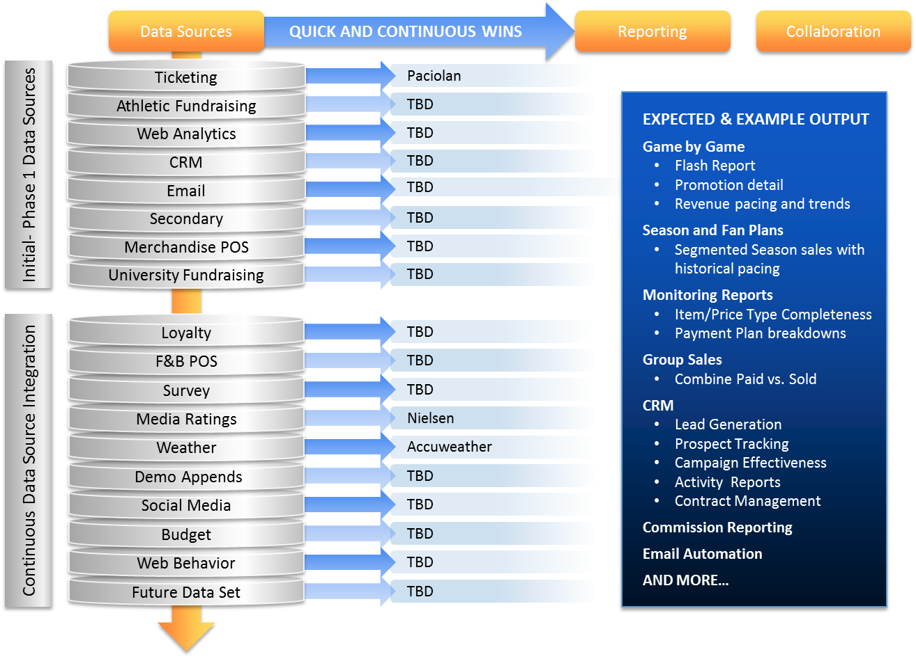
Title

Slide 4
* Milton Overton, Nathan Corder
University of Alabama

Slide 5
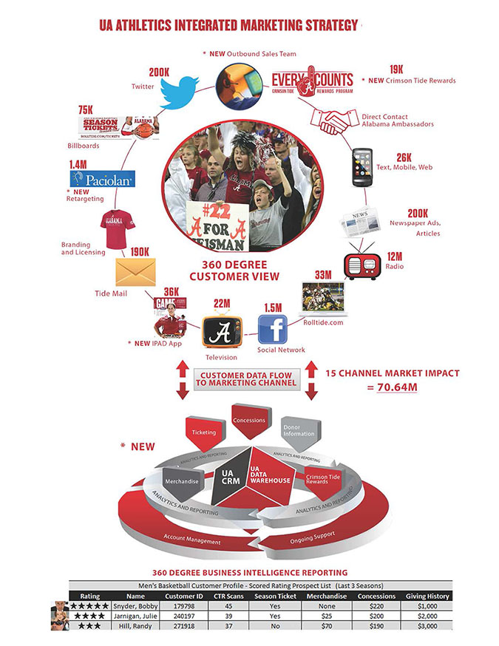
Our Goal- 360° Fan Profile

Slide 6
Starting Out- South Field Suite Sales
Making a Case for Analytics
Result: $108K in new revenue

Slide 7
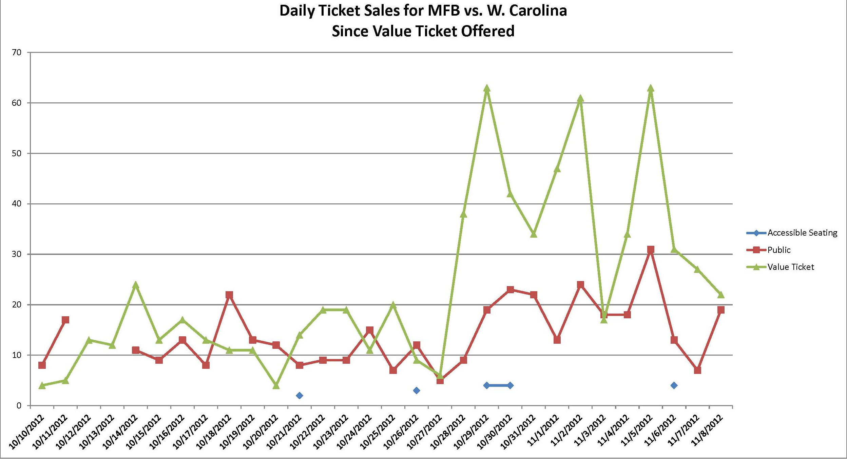
Custom Reporting

Slide 8
Data Visualization- Heat Map (Images Help Build Business Case)
Season Usage Review

Slide 9
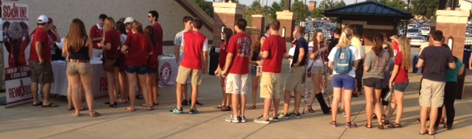
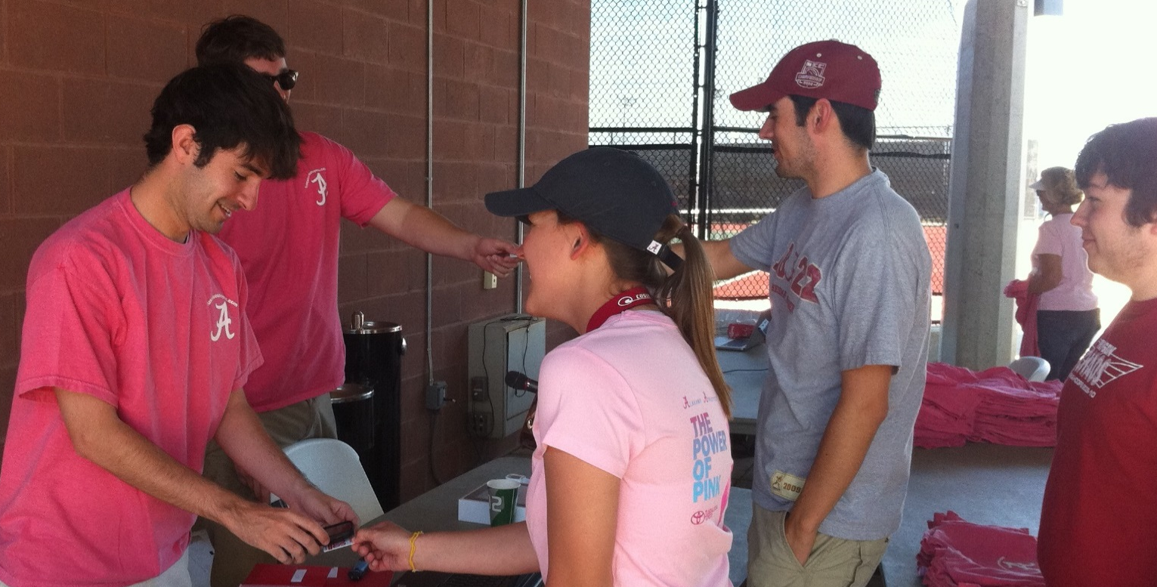
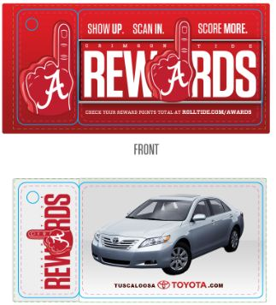
Data Collection Fan Loyalty Program

Slide 10
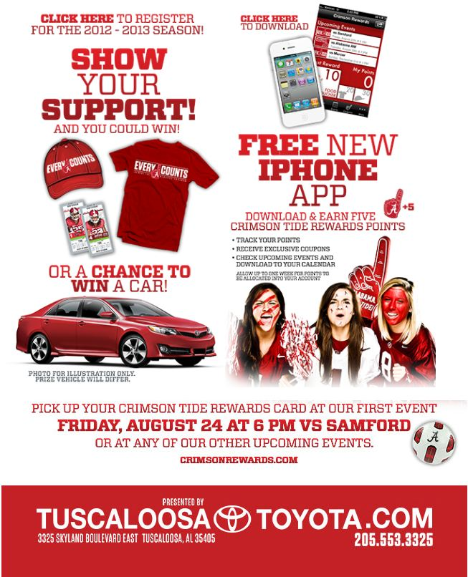
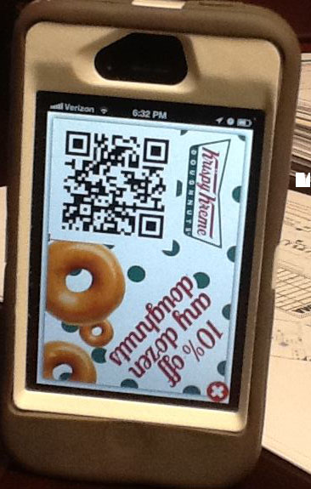
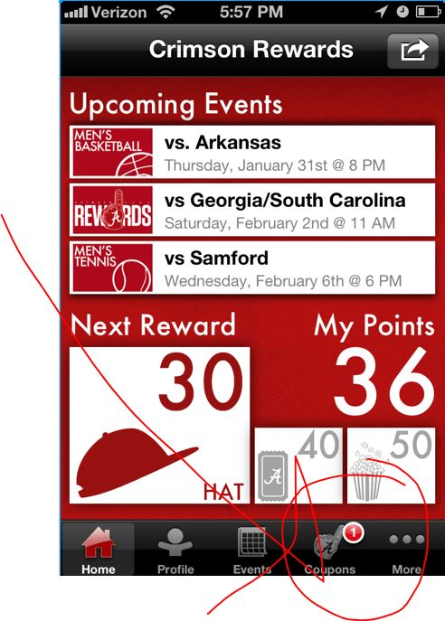
Special Offers to Loyal Customers

Slide 11
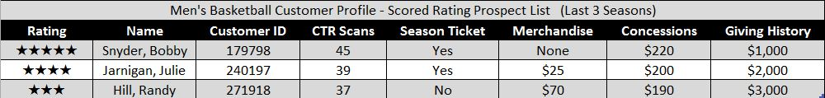
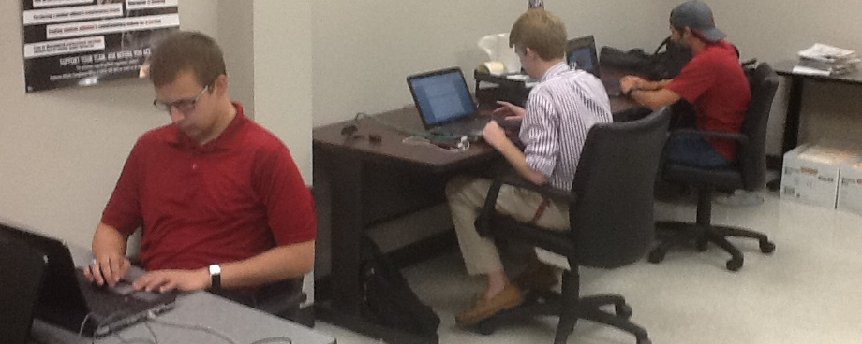
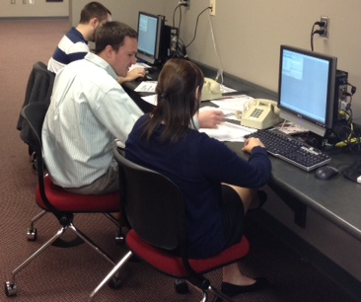
Building Customer Profiles for Targeted Campaigns

Slide 12
Thank You!
Questions?
Please Fill Out Survey

